Slide 1
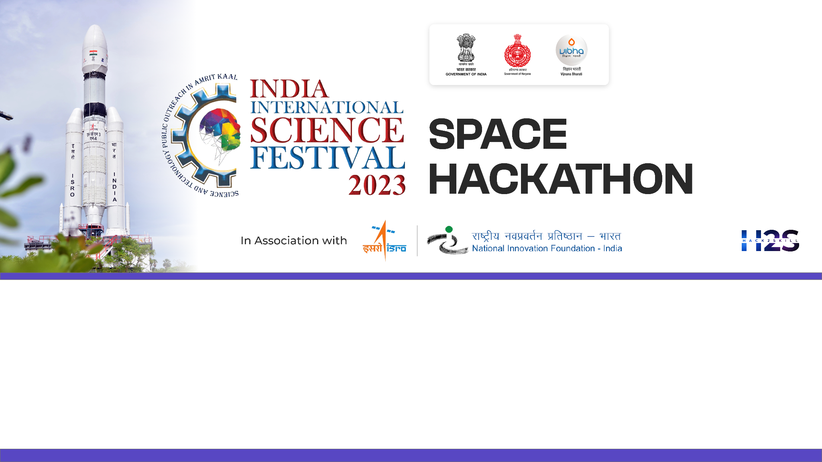

Team Name: Geo-Extractors
Name of College/University: Andhra University College Of Engineering
Team Member Details:
BANDI JAYASATYADURGARAO
JAGU MANISH
GAUTAM KUMAR KUSHWAHA
CHATTI VENKATA RAVITEJA

Slide 2

Problem Statement: Feature Extraction from RS‐HR data using AIML
MOTIVATION:
Leveraging deep learning models, particularly Convolutional Neural Networks (CNNs) and Generative Adversarial Networks (GANs), enhances RS-HR feature extraction and classification.
CNNs enable discernment of subtle differences and fine-grained classification, while GANs aid in addressing imbalanced data distributions. This integrated approach overcomes traditional image processing limitations, improving adaptability, accuracy, and automation in RS-HR applications.
Tangible Benefits
Generating labeled datasets for multiple features
Improved Multi‐label classification model with good generalization capability
Enhances ability to accurately identify and discriminate diverse and visually complex classes, such as different types of ponds or dams
Automation annotation reduces the manual effort and time required for data annotation
Enhances accuracy of fine-grained classification
Improves capturing accuracy of spatial dependencies between multiple features in a scene
Enhances feature extraction capability for feature variations due to weather conditions, and environmental changes.
OUR SOLUTION:
Class-wise labels are generated by taking ground validation data, employing various Image segmentation techniques to label distinct features, complemented by applying diverse OBIA classification methods through Deep neural networks(CNN).
We aim to improve RS-HR feature extraction and classification by the integration of deep learning models, specifically Convolutional Neural Networks (CNNs), issues that conventional image processing was unable to resolve.
The utilisation of CNN in our suggested solution strategy can greatly enhance accuracy in remote sensing applications by assisting in the identification of minute discrepancies, managing unbalanced data, and adjust to various environmental conditions.

Slide 3
Detailed Proposal & Solution Approach
Limitations of Conventional Image Processing Overcome Using ML/DL Models
CNN models for better feature discrimination(for subtle visual differences)
Automatic data annotation by using transfer learning techniques with pre-trained deep learning models by using ResNet or VGG
Capturing intricate visual details for fine-grained classification using YOLO or SSD
Capture spatial dependencies in the data using Convolutional Neural Networks with recurrent connections (e.g., 3D CNNs)
Imbalanced data handling using oversampling, undersampling, or class weights during training in deep-learning models
Training with diverse datasets for model adaptability to environmental changes for encompassing different seasons and weather conditions
U-Net model for handling variations in object sizes to enable accurate detection and classification across different scales
To handle shape complexity semantic segmentation using U-Net
Faster R-CNN model for handling occlusion effect
Model pruning and quantization to address real-time processing constraints
Challenges in Multi-Label Classification:
Heterogeneous features extraction
Annotating large and labeled dataset
Fine-grained classification (like distinguishing differences between ponds or dams)
Capturing spatial dependencies between multiple features
Imbalanced class distributions leads to potential bias in the model
Feature exhibit variations w.r.t seasonality & environmental variations
Features scale variability
Object occlusion, Ambiguity in boundaries, Background complexity, Real-time processing, Consistency across features, Interclass confusion
Traditional / Conventional Image Processing Approach Limitations
Struggle to discern subtle visual differences among features
Lacks the ability to automate the annotation process efficiently
Lack the capacity to capture intricate visual details
Struggle to effectively capture spatial dependencies between multiple features
Not adaptive to variations in feature appearances due to seasonal changes and weather conditions
Struggle to handle partial or complete occlusion of features (like vegetation)
Addressing ambiguous boundaries in complex landscapes
To distinguish features from complex backgrounds (like densely populated urban areas)
Lacks the discriminative power required for precise classification.

Slide 4
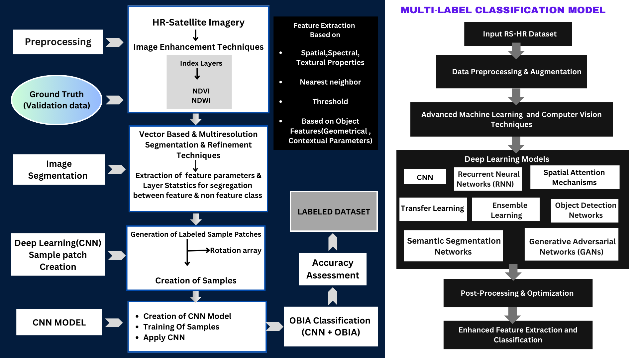
DETAILED METHODOLOGY

Slide 5
Tools and devices used in development:
eCognition
GRASS GIS
QGIS
ERDAS IMAGINE
OpenCV
PyTorch
TensorFlow
Jupyter Notebook
Technologies involved/used:
GIS(Geographic Information System)
Remote Sensing
Digital Image Processing
AI/ML/DL(CNN)
OBIA (Object-Based Image Analysis)
Performance matrix and outcomes
Good Spatial Precision: Intersection over Union(IoU).
Holistic Class Inclusion and Adaptability.
Comprehensive Evaluation Mastery.
References/Acknowledgement
Kucharczyk, M., Hay, G. J., Ghaffarian, S., & Hugenholtz, C. H. (2020). Geographic Object-Based Image Analysis: A Primer and future directions. Remote Sensing, 12(12), 2012. https://doi.org/10.3390/rs12122012
O’Neil‐Dunne, J., Specialist, G., & Pelletier, K. C. (2011b). Incorporating contextual information into object-based image analysis workflows. INCORPORATING CONTEXTUAL INFORMATION INTO OBJECT-BASED IMAGE ANALYSIS WORKFLOWS, 387–397. https://www.asprs.org/a/publications/proceedings/Milwaukee2011/files/ONEILDUNNE.pdf
Chen, G., Weng, Q., Hay, G. J., & He, Y. (2018). Geographic object-based image analysis (GEOBIA): emerging trends and future opportunities. Giscience & Remote Sensing, 55(2), 159–182. https://doi.org/10.1080/15481603.2018.1426092
Tripathi, M. (2021). Analysis of Convolutional Neural Network-based Image Classification Techniques. Journal of Innovative Image Processing, 3(2), 100–117. https://doi.org/10.36548/jiip.2021.2.003

